Slide 1
Effects of Noise on Deutsch-Jozsa Algorithm
Presenter: Stephen Aranda

Slide 2
Introduction
This presentation will discuss the effects of noise, specifically T1 relaxation noise, on the Deutsch Jozsa algorithm. But before we do that…
Briefly discuss the standard Deutsch-Jozsa algorithm
Discuss and compare the implementation of this experiment with the Deutsch-Jozsa algorithm

Slide 3
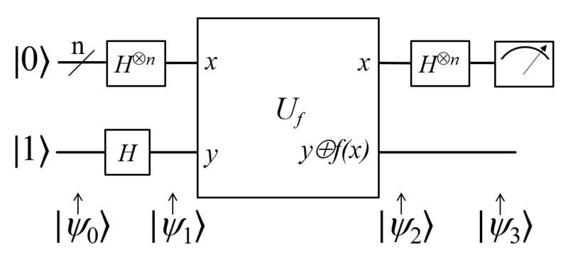
Deutsch-Jozsa Algorithm Overview
This is a quantum circuit diagram of the standard Deutsch-Jozsa algorithm

Slide 4
Hadamard Gate Hamiltonian
Result of calculations made for the creation of Hamiltonian to physically realize Hadamard gate for 2 qubit system
1 1 1 1
1 -1 1 -1
1 1 -1 -1
1 -1 -1 1
H₁₂ = - b / 4

Slide 5
Z Gate Hamiltonian
Result of calculations made for the creation of Hamiltonian to physically realize Z gate for 2 qubit system
1 0 0 0
0 -1 0 0
0 0 1 0
0 0 0 -1
H_{z2} = b / 2

Slide 6
T 1 Noise Applied To Flipped State |01〉
This is the resulting T1 noise that came from solving the second term of the Lindblad Master Equation.
0 0 0
0 -1 0 0
0 0 0 0
0 0 0 0
dρ/dt = γ [ e^{-iH12t/h-bar}
e^{iH12t/h-bar} ]

Slide 7
There Is No T1 Noise Injected Into The Ground State
It is found that after solving for the second term of the Lindblad Master Equation that the amount of noise injected into the ground state is zero. There is nothing to relax.

Slide 8
Now Let’s Talk About The Trials

Slide 9
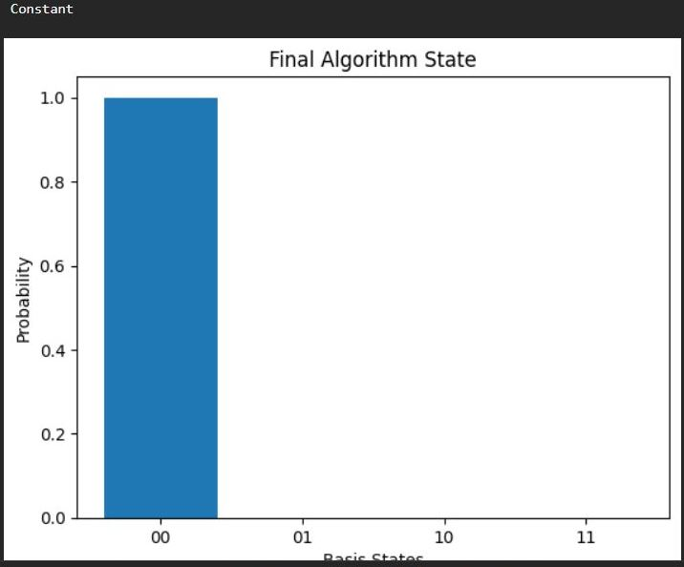
Ideal Scenario Trial One-Constant Test

Slide 10
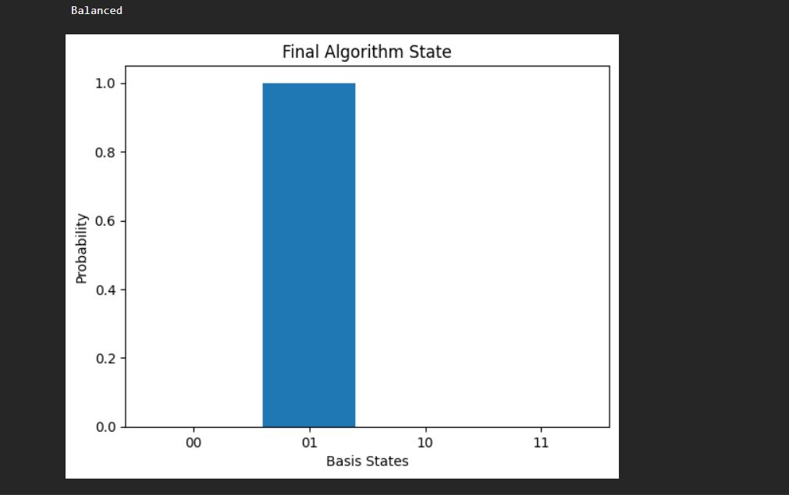
Ideal Scenario Trial One-Balanced Test

Slide 11
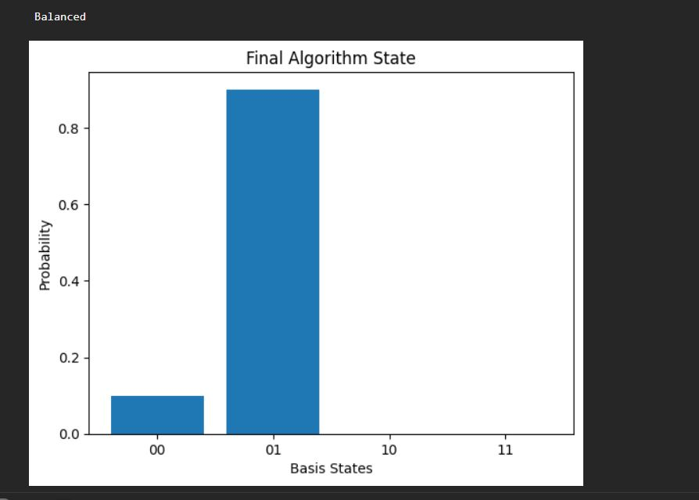
Trial Two-Noise Injection For One Second

Slide 12
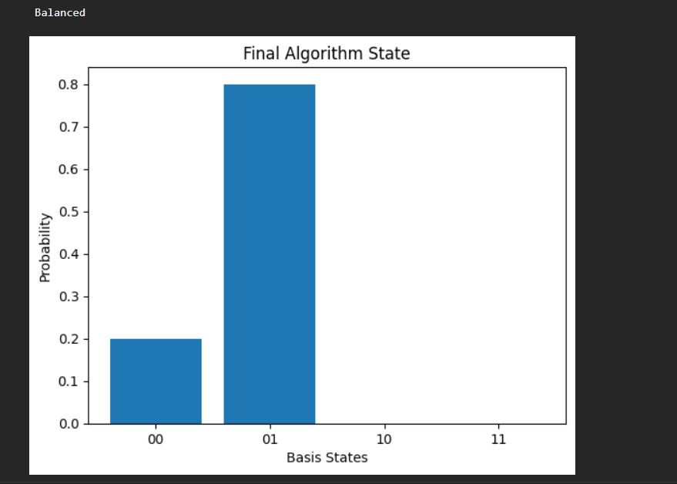
Trial Three-Noise Injection For Two Seconds

Slide 13
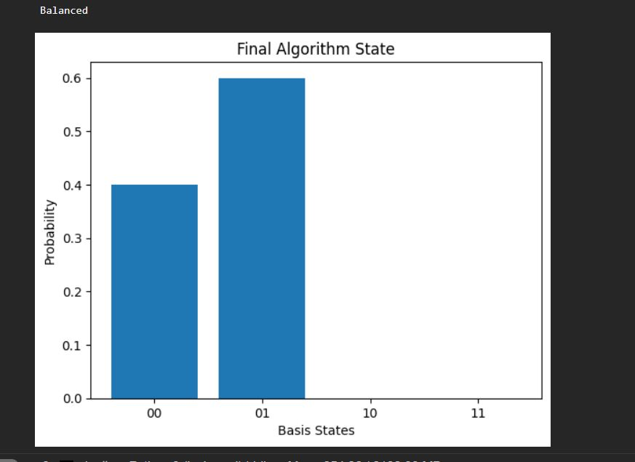
Trial Four-Noise Injection For Three Seconds

Slide 14
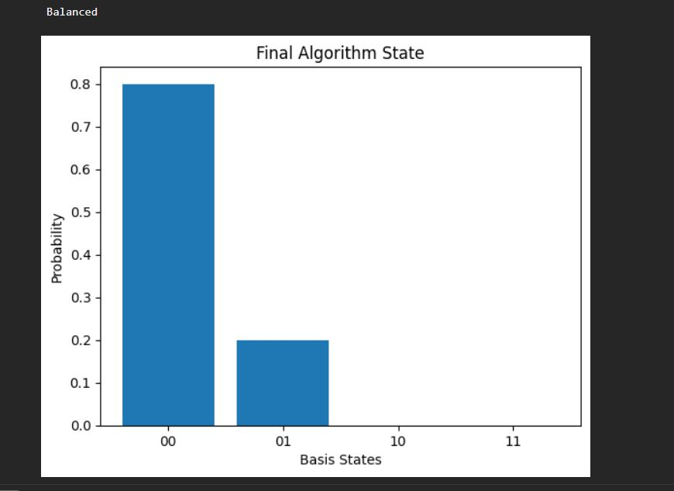
Trial Five-Noise Injection For Four Seconds

Slide 15
What is the purpose of this experiment?

Slide 16
Thank you
Stephen Aranda

